Slide 1
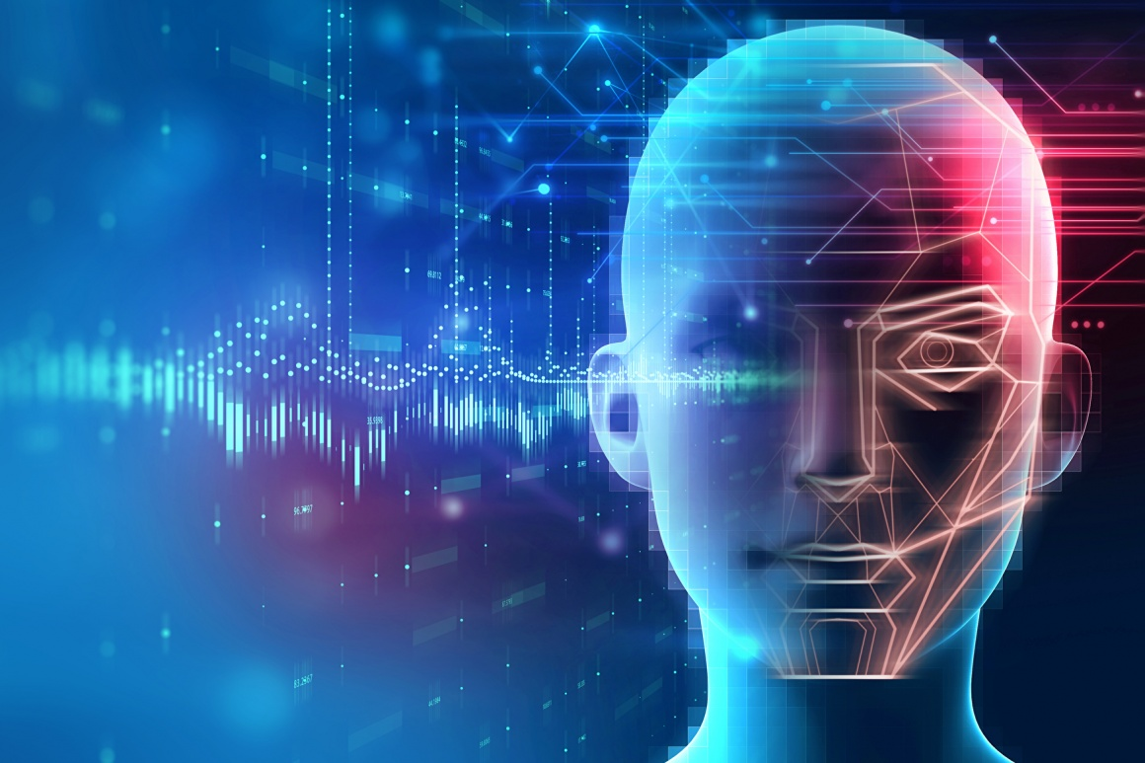
Campus Ambassador Program Hackathon
Presented By:-
Team Name: Dominators

Slide 2
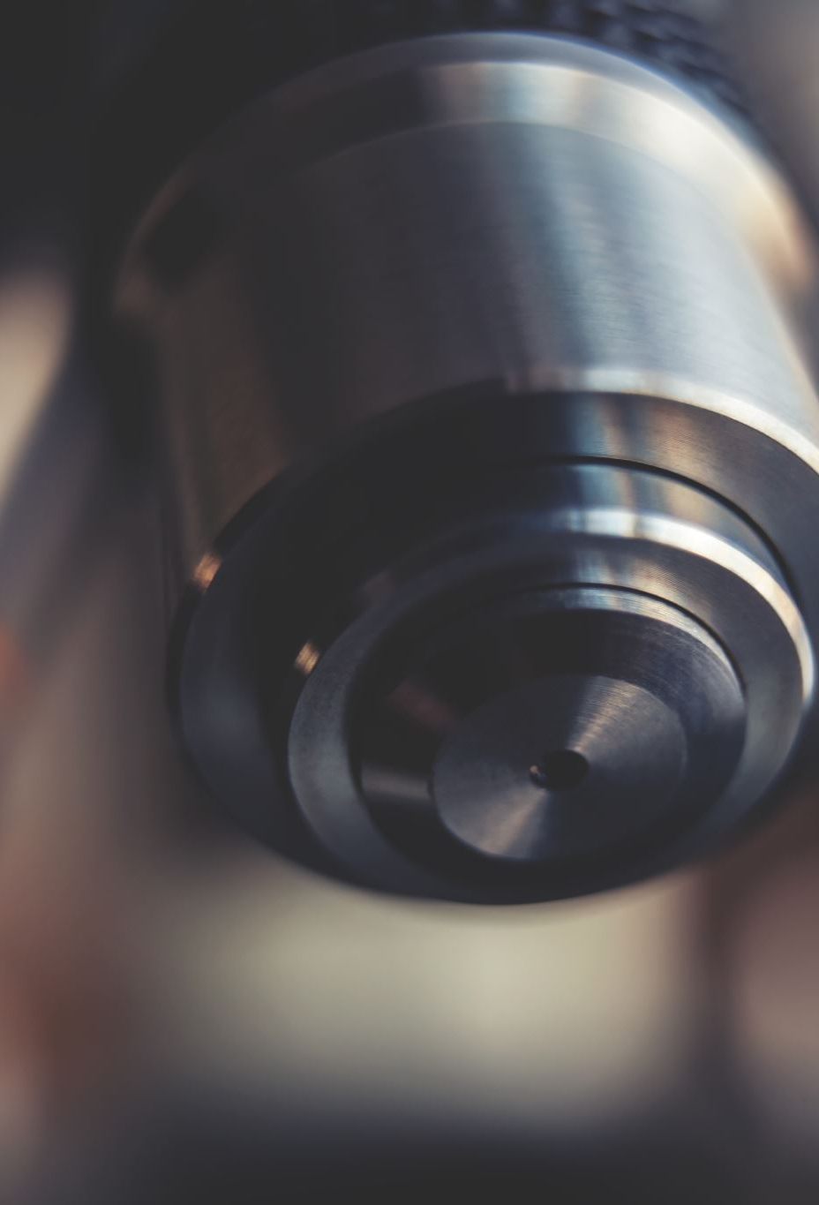


TOPIC:
DETECT TAILGATING AND ALERT SECURITY STAFF

Slide 3
What is RFID Card Reader and How it works
Radio Frequency Identification (RFID) is the wireless non-contact use to transfer data.
It allows users to uniquely identify and track inventory and assets.
The cost of implementing RFID system continues to decrease, making it more cost-effective.

Slide 4
Benefits and components
Return on Investment (ROI)
Application Feasibility
Cost Feasibility
COMPONENTS:
Readers
Antennas
Tags
Cables

Slide 5
What is Tailgating
When an employee opens the door, any number of people can follow behind the employee and enter into the building. Similarly, when an employee exits the building, it is very easy for a person to grab the door and enter the building as the employee is leaving. This practice is known as "tailgating" or "piggybacking".
the "tailgater" may even call out to the employee to hold the door open for him or her.
It can also be performed using devices through installation of cameras and microphone for capturing confidential information.

Slide 6
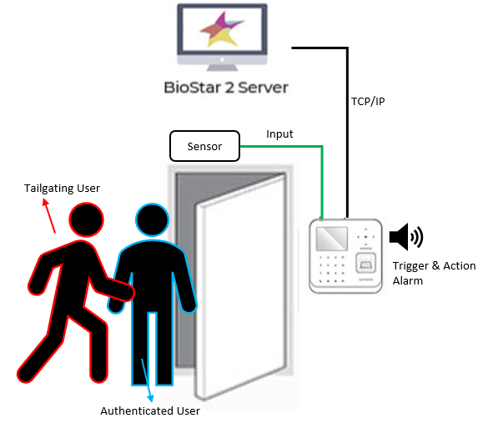
Example of tailgating
As we can observe the image, one user is tailgating with the authenticated user through rfid card reader.

Slide 7
SOLUTION:
Problem 1:If a stranger tries to enter the building using authorized user’s rfid card.
Solution: while the person punches his rfid card on the machine, the cctv footage can be matched simultaneously with facial biometrics linked to the rfid card in the database which gives us a confirmation if the employee himself is using the card or not’

Slide 8
Problem 2: if many unauthorized users follow the only authorized user.
Solution: we can use IMAGE SEGMENTATION to segment all the humans in the group. Afterwards image of all the people are captured then the face recognition model is applied to match with our existed database whether all are authorized or not and if anyone is unauthorized the door will not be open and if he tries to enter the alarm will ring as only known person will be allowed to enter.

Slide 9
Problem 3:if any device or animal tries to enter the door through human help with active microphone and camera.
Solution:
we use RF signals at the door with sensor to detect any active microphone and cameras.
If any microphone or camera are detected through the sensors the alarm will ring and indicate the same.

Slide 10
opencv
Tailgating can be stopped using computer vision
Computer vision is a field of artificial intelligence that trains computers to interpret and understand the visual world. Using digital images from cameras and videos and deep learning models, machines can accurately identify and classify objects — and then react to what they “see.”
Computer vision works in three basic steps:
Acquiring an image through video, photos or 3D technology for analysis.
Processing the image Deep learning models automate much of this process
Understanding the image object is identified or classified

Slide 11
Face recognition
face recognition is a method of identifying or verifying the identity of an individual using their face.
Face recognition systems can be used to identify people in photos, video, or in real-time

Slide 12
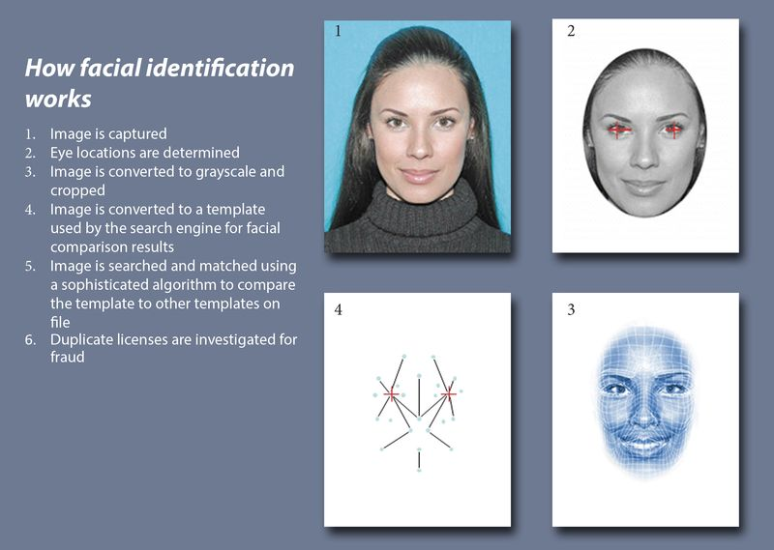
How face recognition works?

Slide 13
Image segmentation
image segmentation is the process of partitioning a digital image into multiple segments (sets of pixels, also known as image objects).
Image segmentation is typically used to locate objects and boundaries (lines, curves, etc.) in images.
image segmentation is the process of assigning a label to every pixel in an image such that pixels with the same label share certain characteristics.
The result of image segmentation is a set of segments that collectively cover the entire image, or a set of contours extracted from the image.
Each of the pixels in a region are similar with respect to some characteristic or computed property, such as color, intensity, or texture.

Slide 14

conclusion
Image recognition is a futuristic and relatively unexplored field, with wide areas of practical applications, including industrial, scientific and medical applications
This field has a lot of potential for development and implementation in new areas like space exploration, processing signal images, computer vision etc.
A lot of tasks can be automated using Image Recognition like processing cheques in banks etc.

